Slide 1

COVID-19 Effect on Global Economy

Slide 2
Introduction
Everyone knows that COVID-19 is current worldwide hot topic, deadly virus outbreak from Wuhan(China)
Disease causes respiratory illness with symptoms such as a cough, fever and many more sever cases.

Slide 3
Potential Economic Impact of COVID-19
Direct Cost from Sickness & Mortality
Aversion Behavior
Government Mandates
Firm and Institutional Decisions
Consumer Choices
Health Sector
Education
Manufacturing
Retail Services
Trade & Transport
Short-Run Effect
Long-Run Effects
Wages & Income falls
Poverty hikes
Loss of Human Capital
Infrastructure Deterioration

Slide 4
1) Travelers are cancelling flights 2) Business ask workers to stay home 3) Global Economy indexes are falling 4) More than 23,000 people have died worldwide, and >500,000 people are infected ….

Slide 5
COVID-19 effects on Canadian economy
Conference Board of Canada predicts that the COVID-19 will impact the country’s economy for years to come.
In comparison with our baseline scenario, the bigger negative impact on the Canadian economy is the result of lower energy and resource investment, weaker exports, and a drastic decline in household spending.

Slide 6
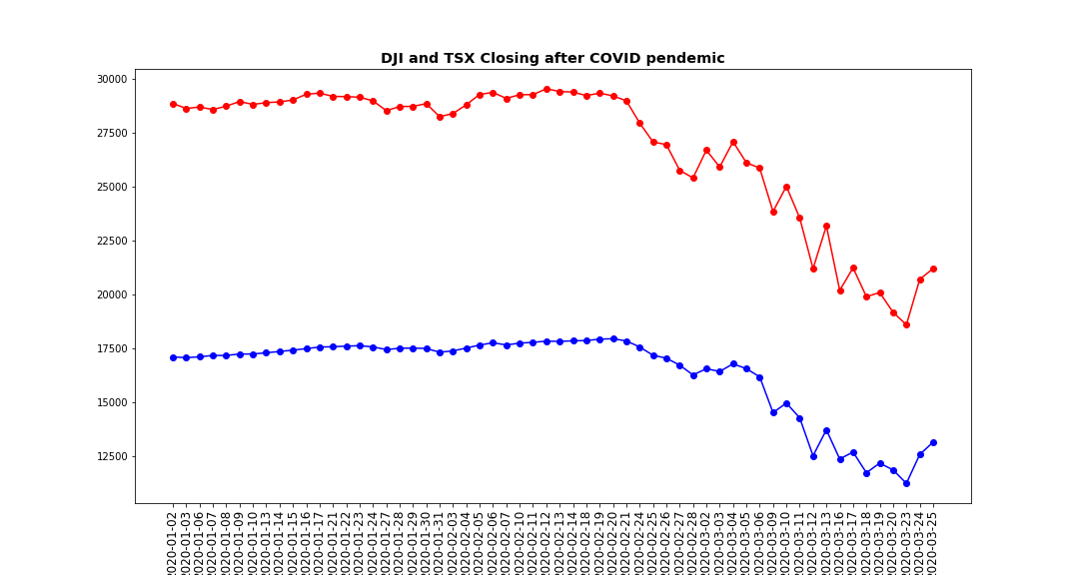
Assessing the economic impact of COVID-19

Slide 7
Data Sources
https://ourworldindata.org/coronavirus
https://covid.ourworldindata.org/data/ecdc/total_cases.csv
https://covid.ourworldindata.org/data/ecdc/total_deaths.csv
https://covid.ourworldindata.org/data/ecdc/new_cases.csv
https://covid.ourworldindata.org/data/ecdc/new_deaths.csv
https://www.ecdc.europa.eu/sites/default/files/documents/COVID-19-geographic-disbtribution-worldwide
Economic data for DJI and TSX from https://ca.finance.yahoo.com/

Slide 8
Technologies
D3.js
Flask
Python (Pandas, Matplotlib)
HTML, CSS and Java Script

Slide 9
Limitations
Current Data Source don’t have geo locations.
I have found some other data sources which has geo locations and I will try to include those in my extension of this project. I will use geopandas or leaflet.js for the extension of the project.

Slide 10
Conclusion
Invisible bug not only destroys a big application but also destroy world.

Slide 11

Questions

